Slide 1

RUNGTA COLLEGE OF DENTAL SCIENCES & RESEARCH
LASERS IN PEDIATRIC DENTISTRY
DEPARTMENT OF PEDODONTICS AND PREVENTIVE DENTISTRY

Slide 2
SPECIFIC LEARNING OBJECTIVES
Core areas | Domain
Introduction Types of laser principle of laser radiation | Laser delivery system Laser tissue information

Slide 3
CATEGORY
MUST TO KNOW
NICE TO KNOW
Laser tissue interaction
DESIRE TO KNOW
Laser delivery system
Basic laser science
Components of laser

Slide 4
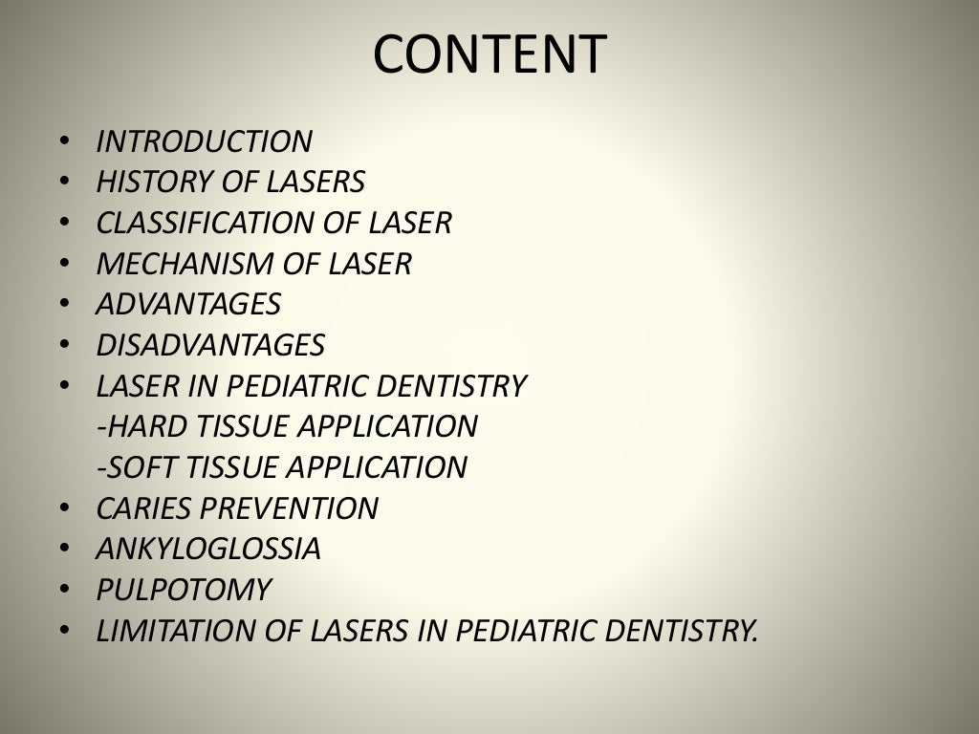

Slide 5
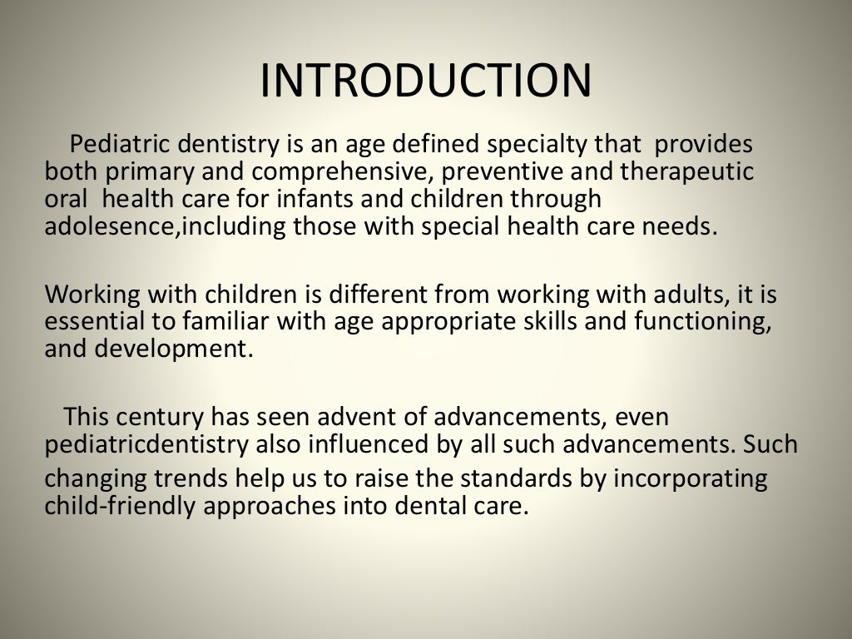

Slide 6
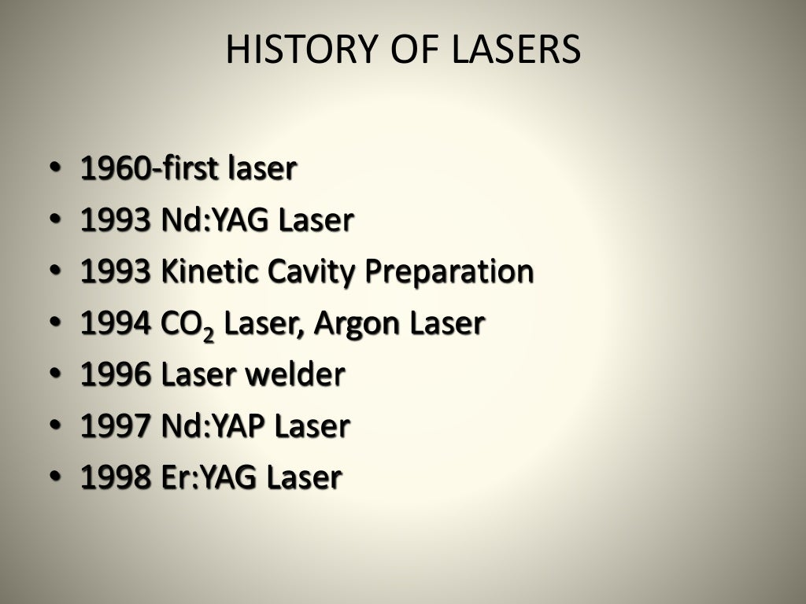

Slide 7
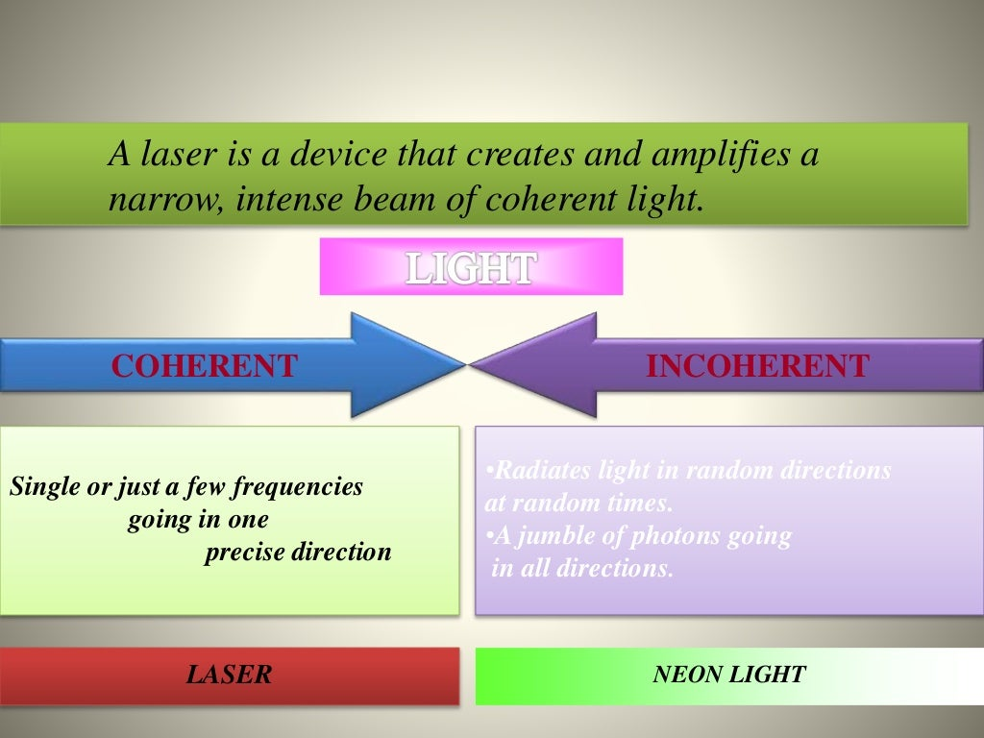

Slide 8
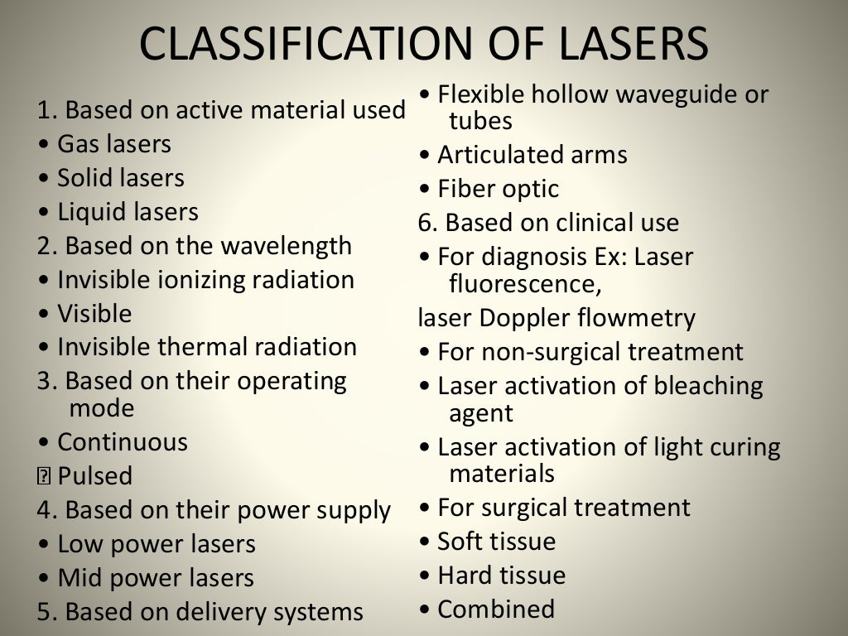

Slide 9
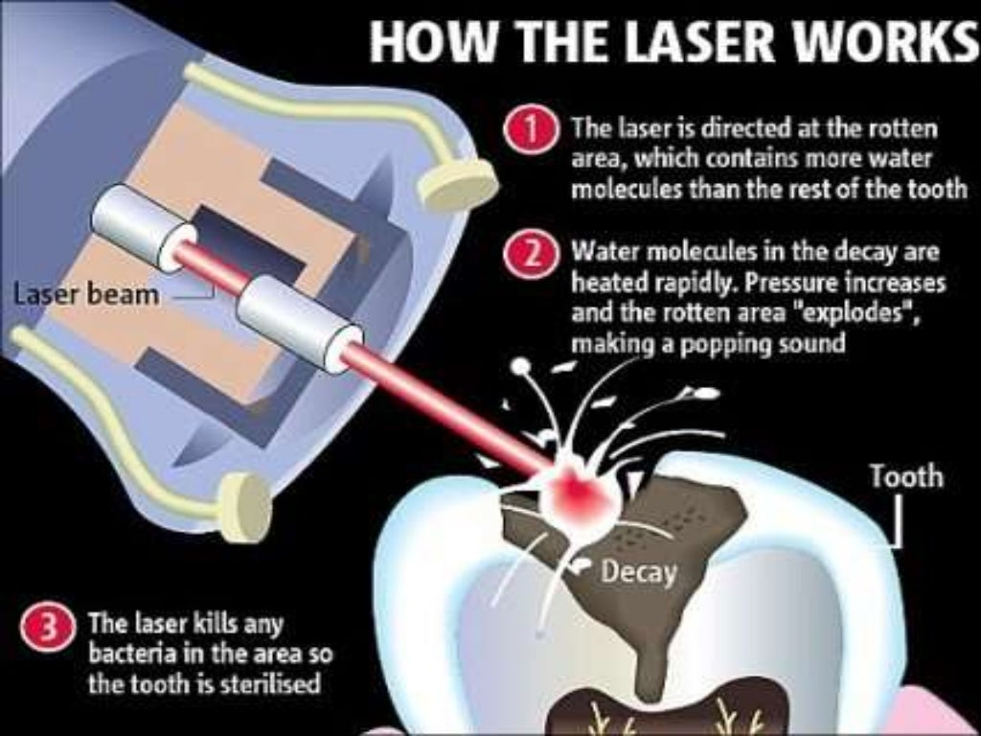

Slide 10
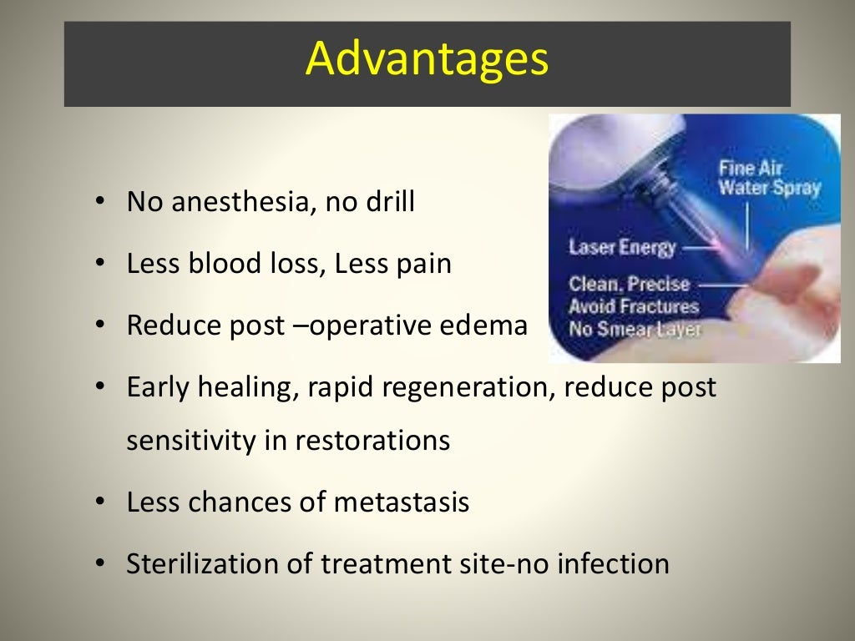

Slide 11
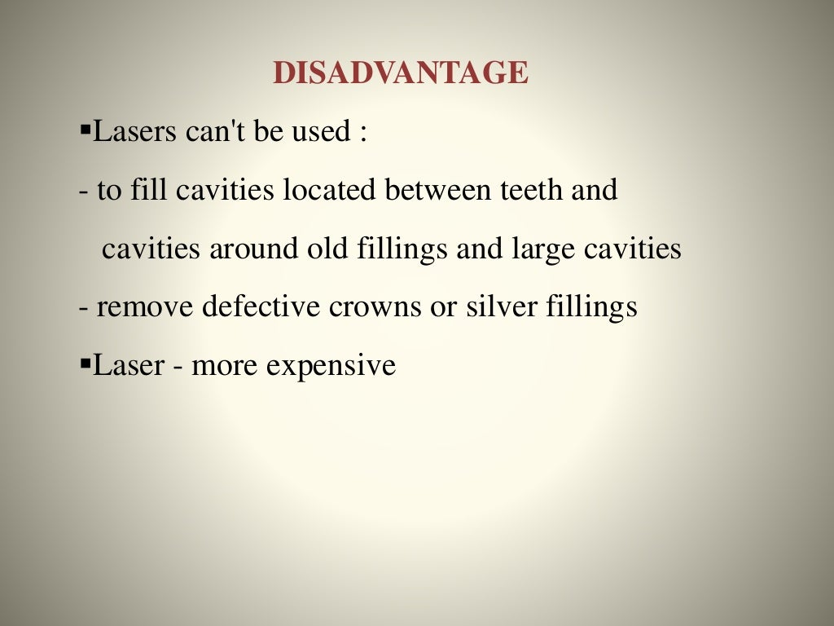

Slide 12
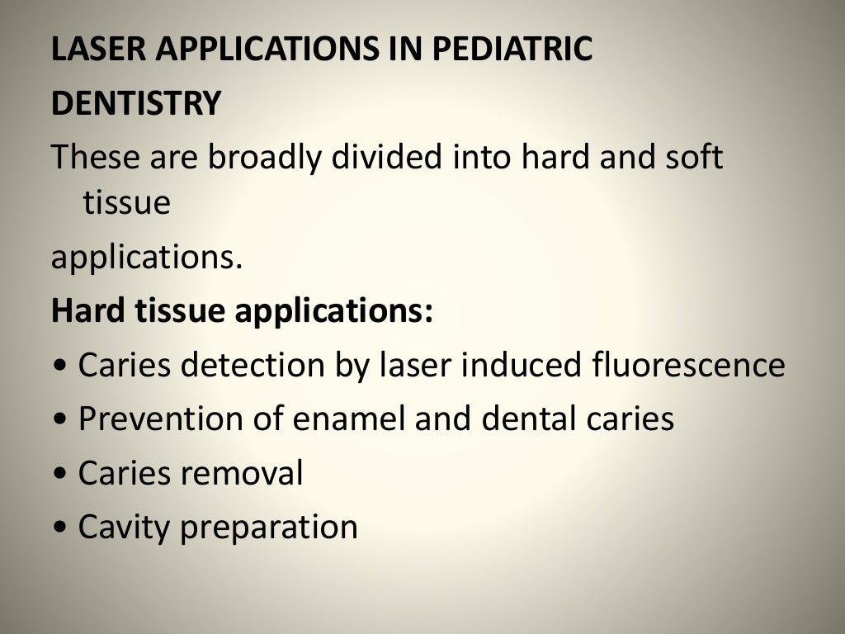

Slide 13
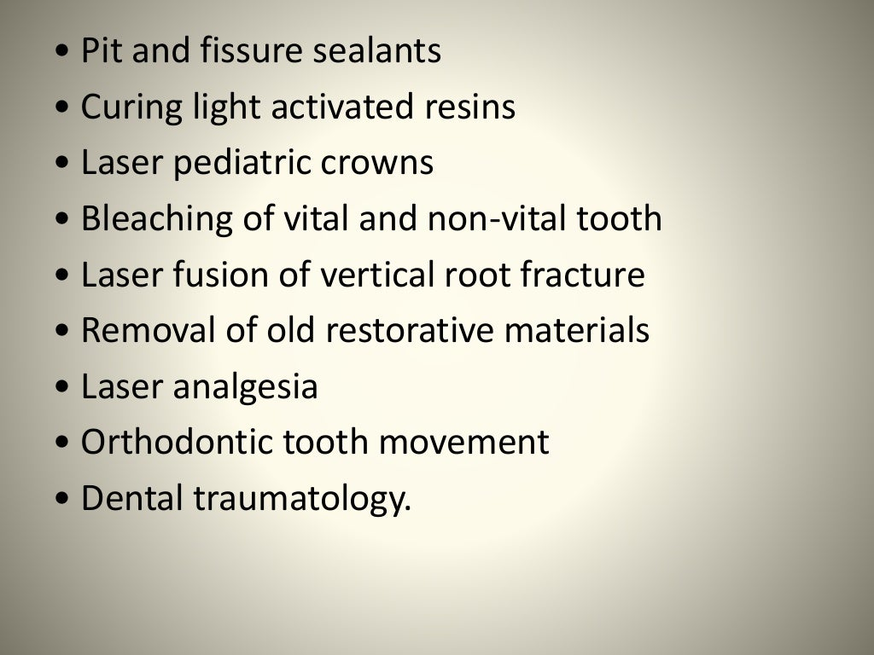

Slide 14
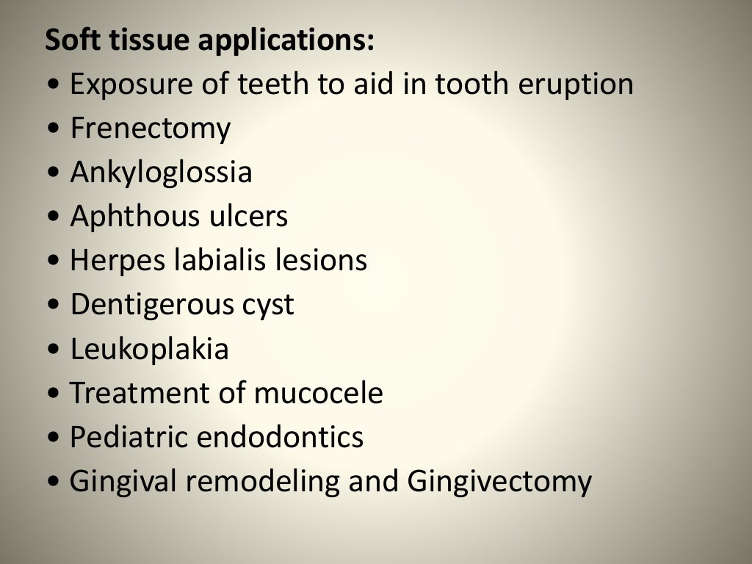

Slide 15
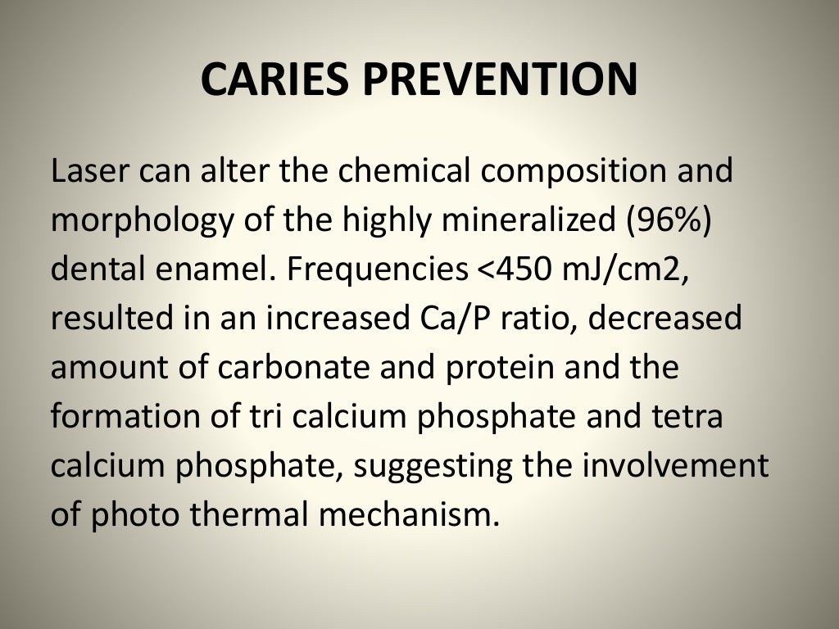

Slide 16
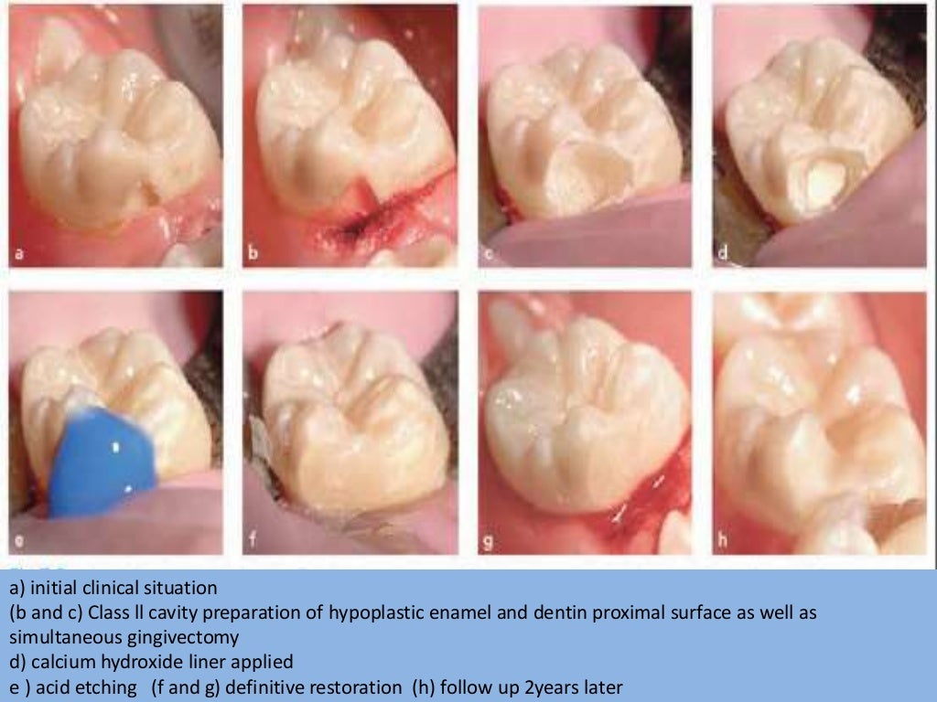

Slide 17
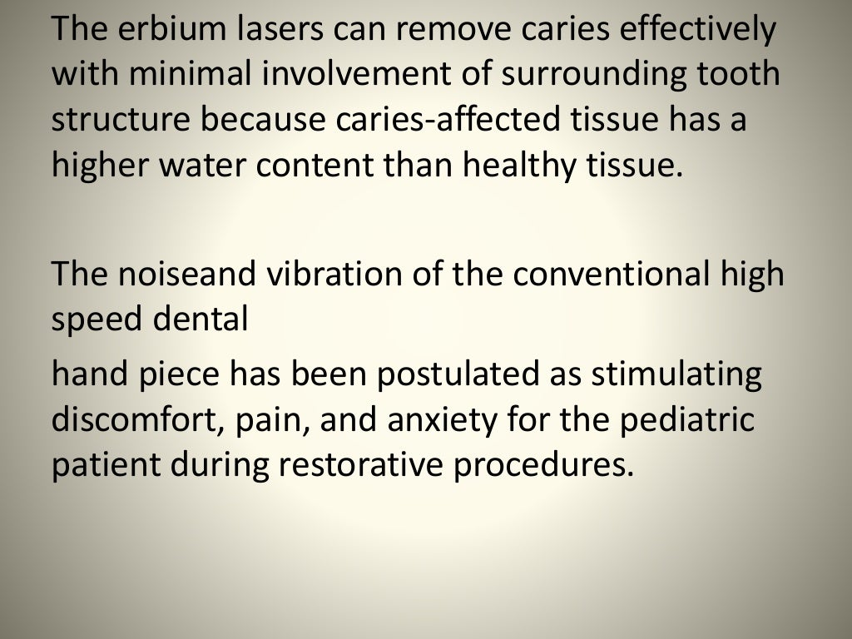

Slide 18
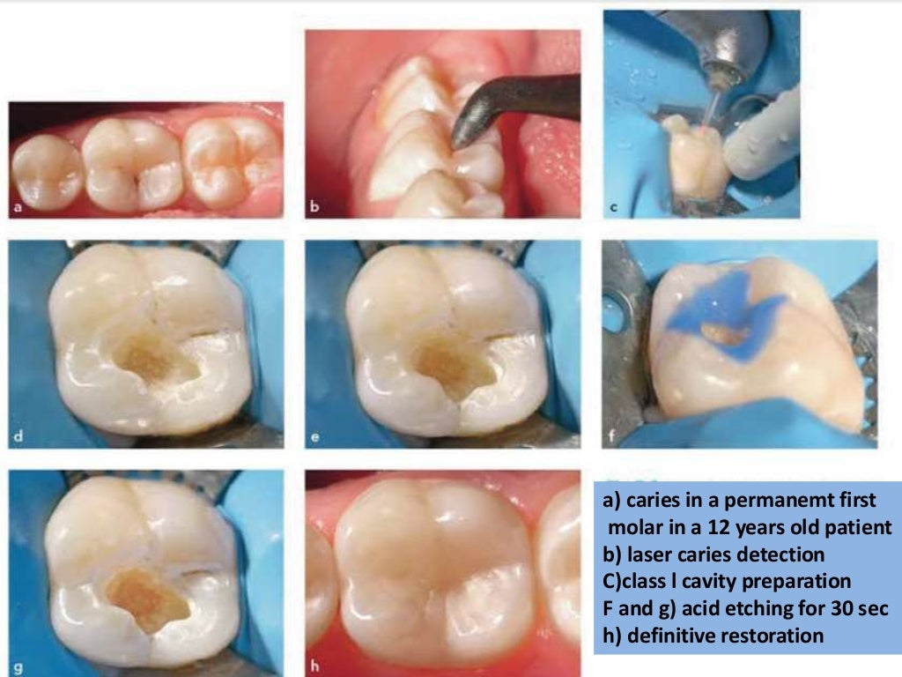

Slide 19
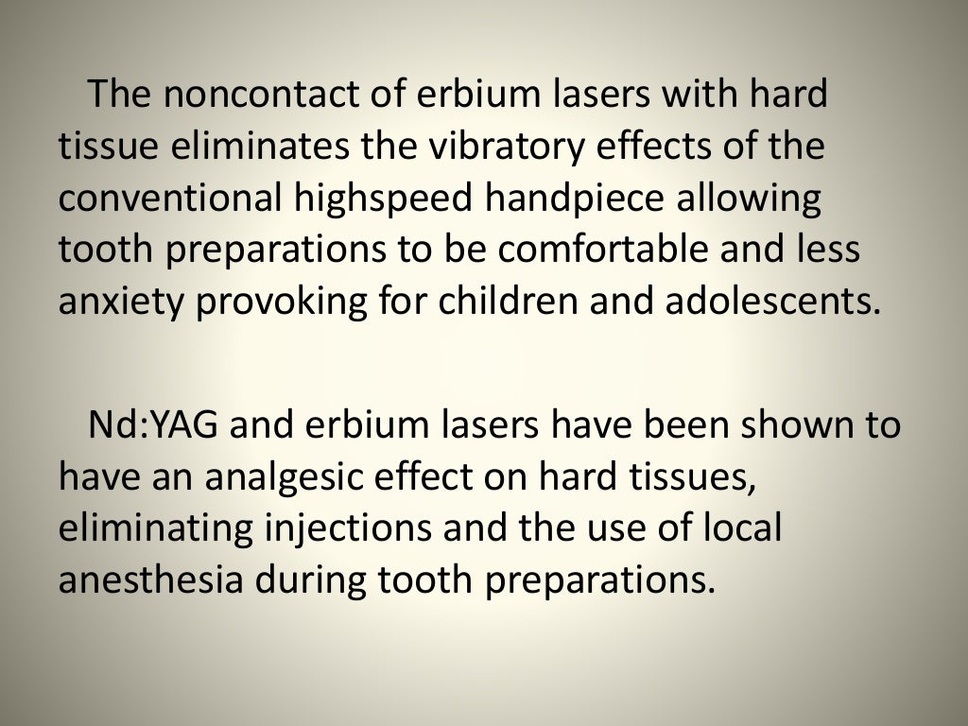

Slide 20
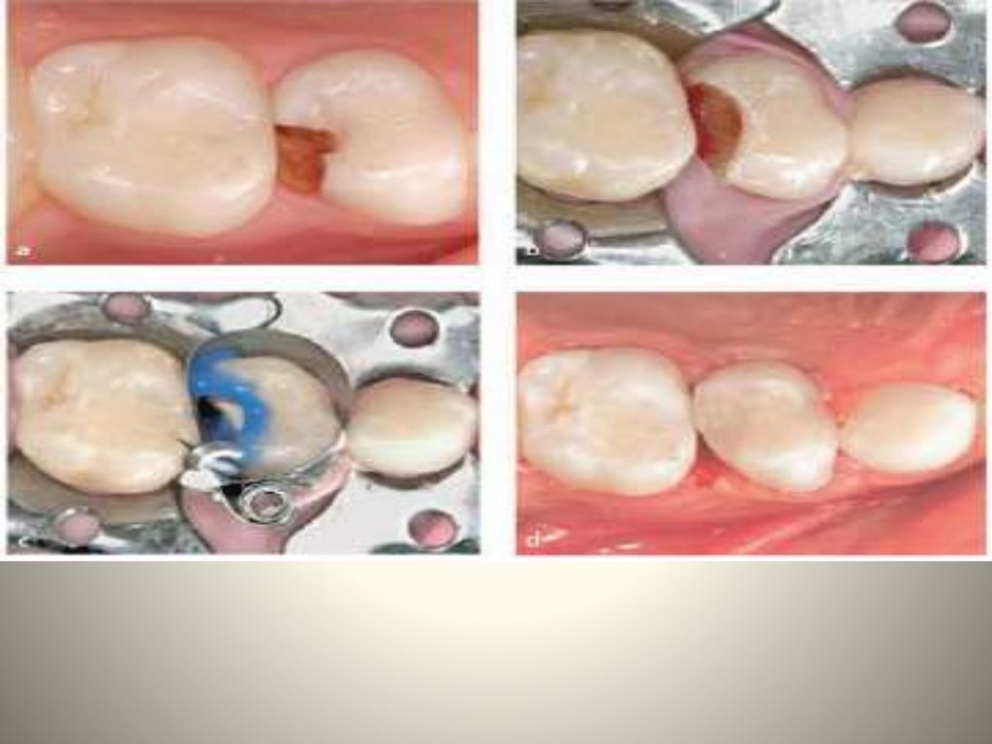

Slide 21
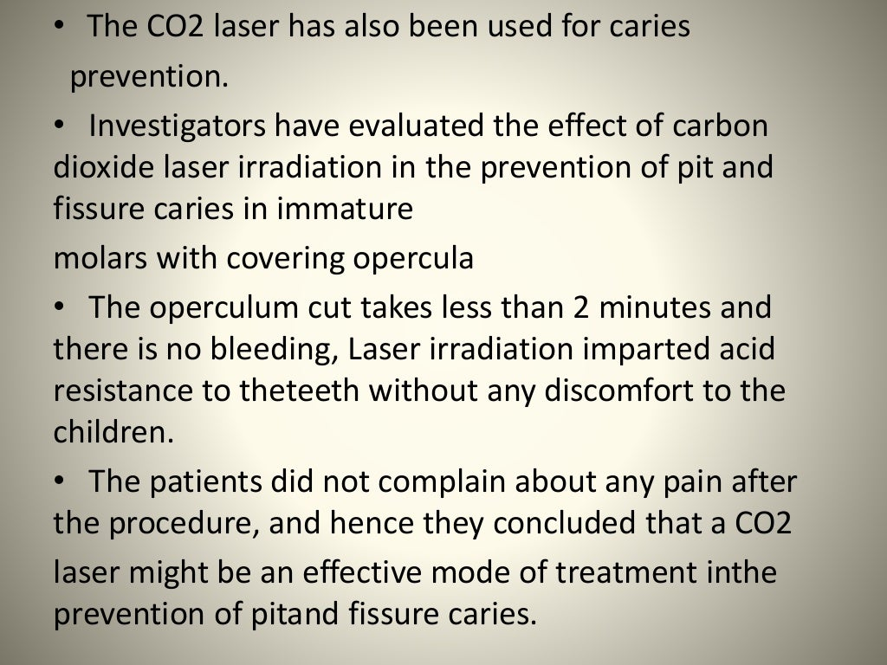

Slide 22
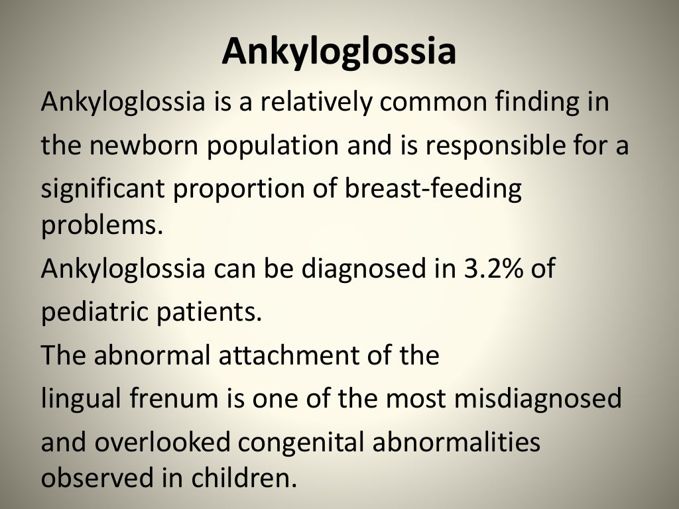

Slide 23
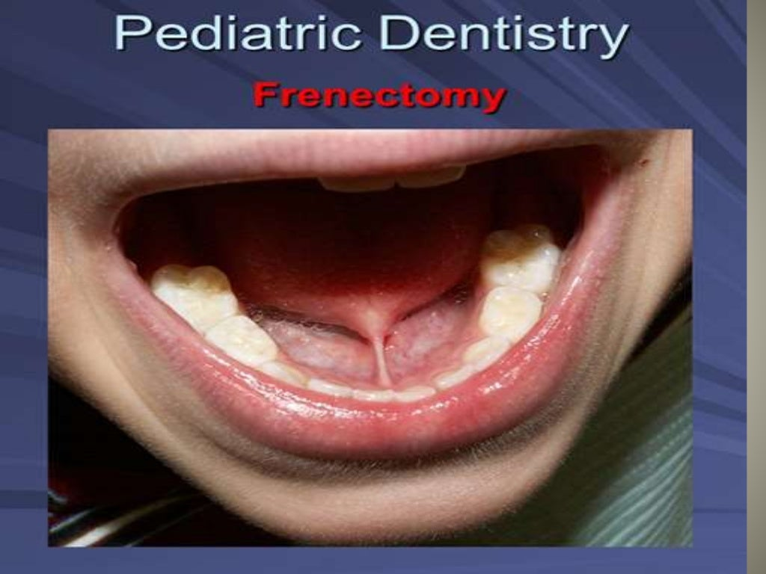

Slide 24
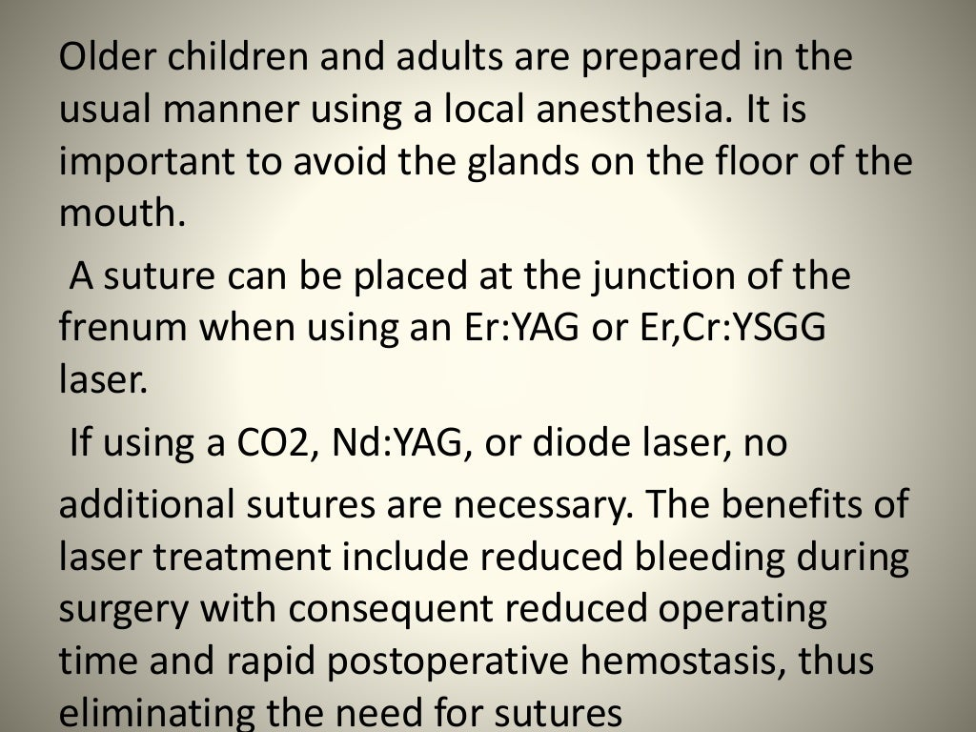

Slide 25
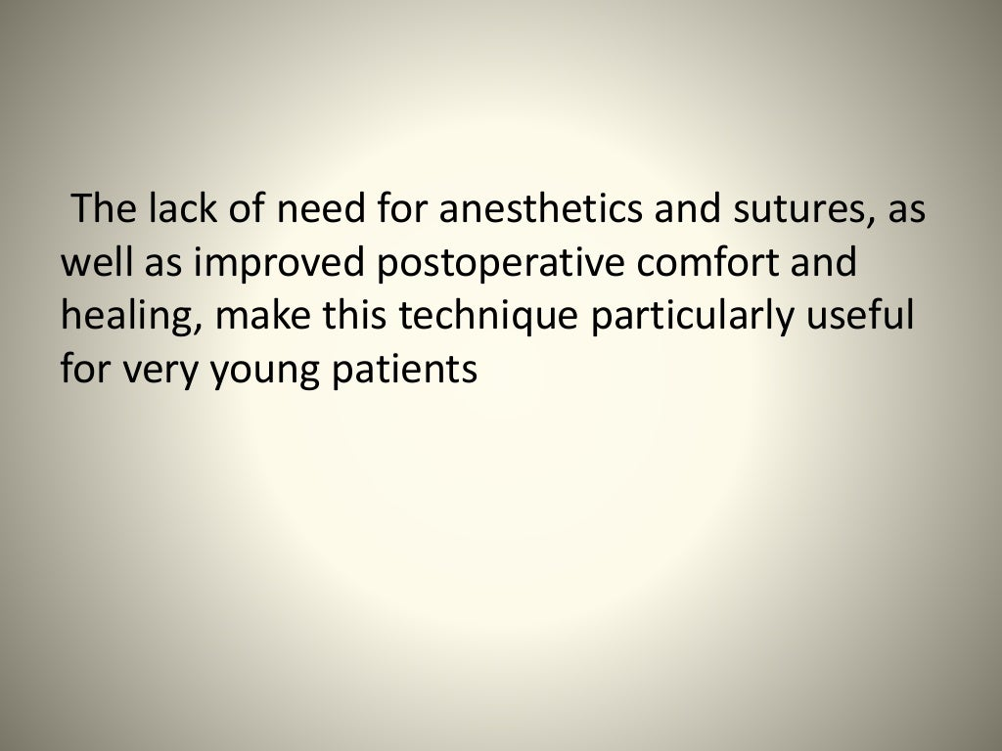

Slide 26
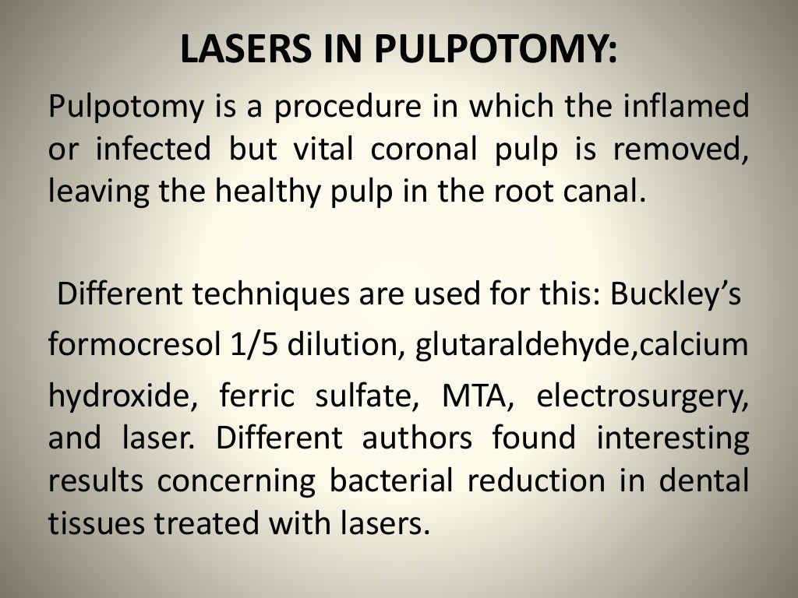

Slide 27
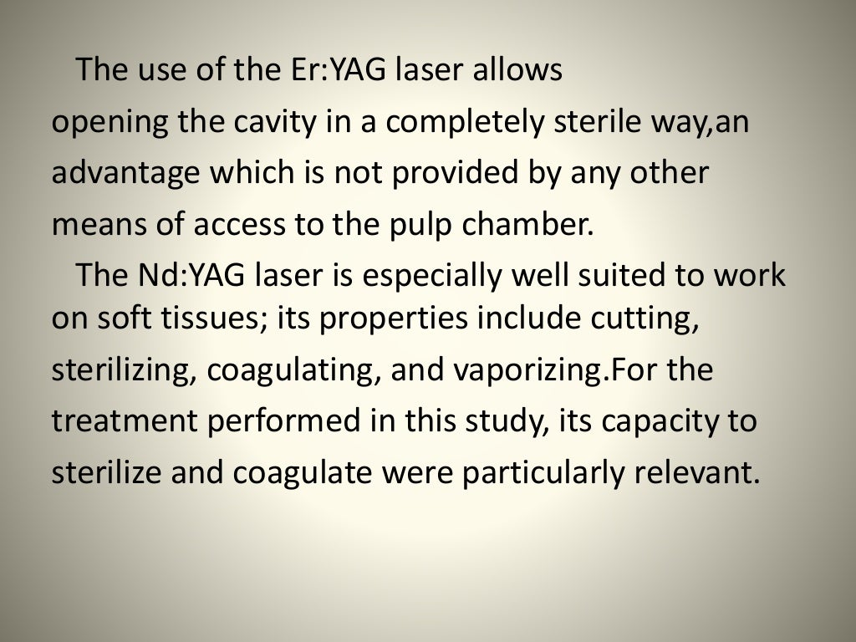

Slide 28
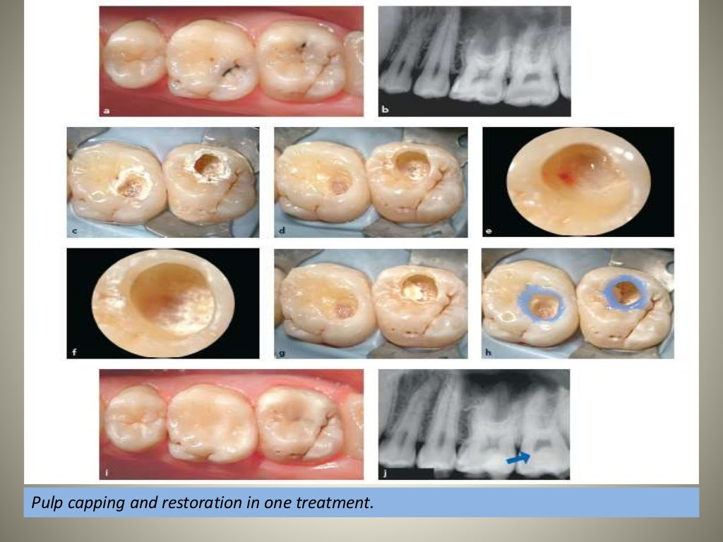

Slide 29
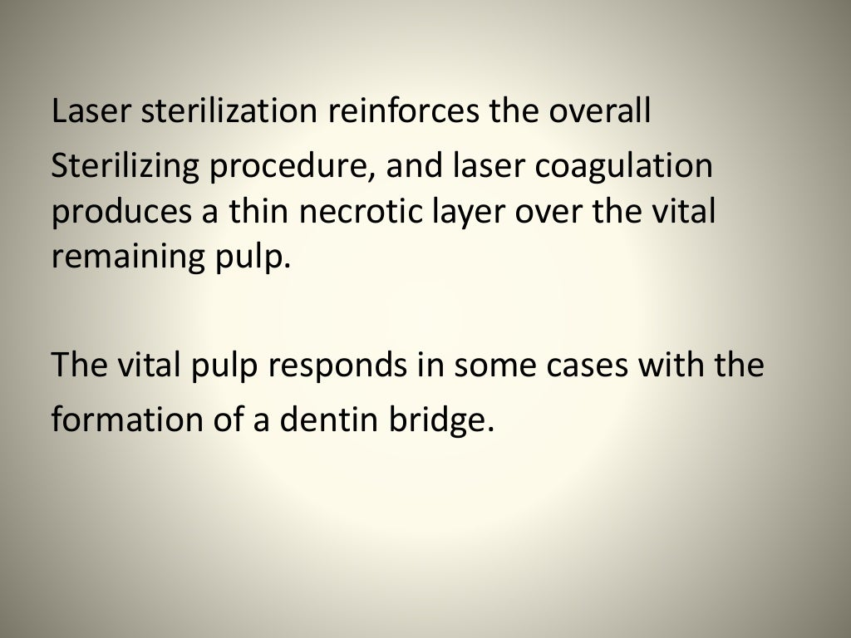

Slide 30
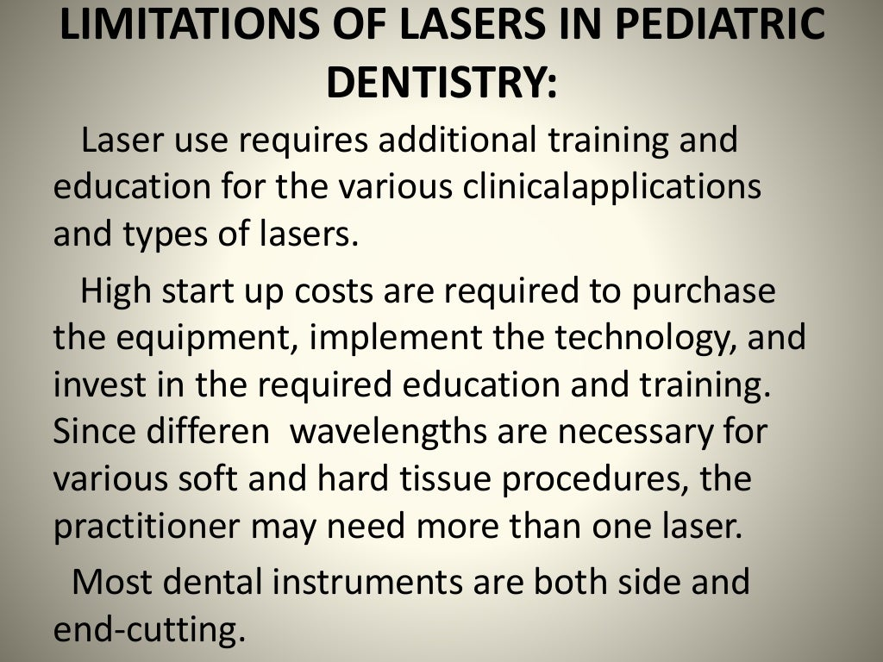

Slide 31
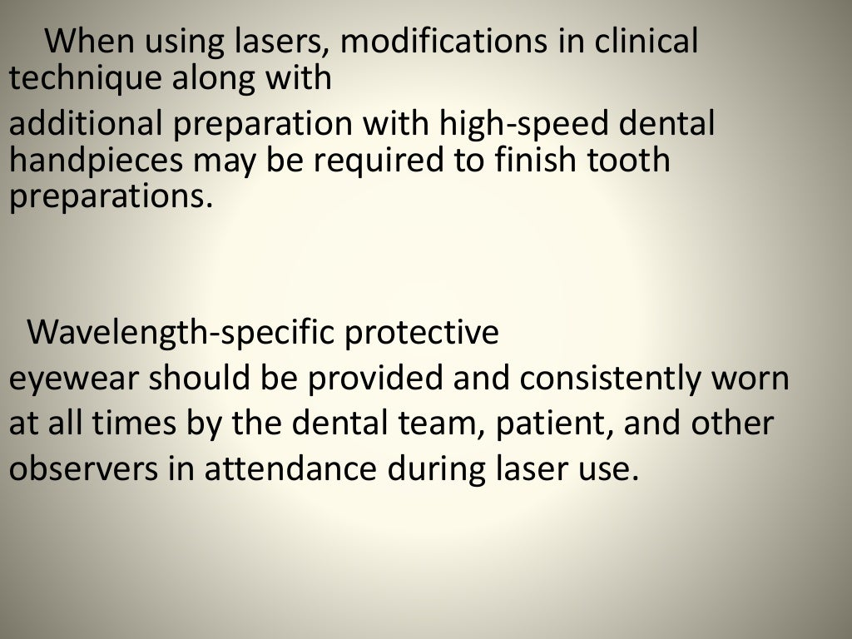

Slide 32
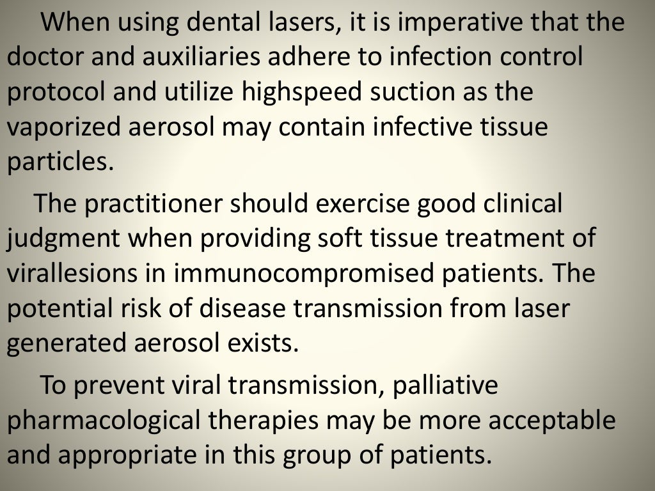

Slide 33
TAKE AWAY HOME MESSAGE
The best instrument associated with laser for caries diagnosis is diagnodent.
Argon laser is the best used for prevention of caries as it alters the surface characteristic of enamel to make it more caries resistance.
Laser hazards include tissue damage, respiratory hazards, fire and explosion and electric shock.

Slide 34


